Slide 1
Vision Development … of proposed Missional Church Support Network whether limited or more expansive

Slide 2
Vision Development … What are we seeking to do? Primarily a lay-oriented initiative, reflecting a sense of Christian social responsibility in the larger community.

Slide 3
Vision Development … My personal orientation/identity
Church lay involvement (is there a role for such leadership)
Active in public education/academia and NGO organizations
Active in poverty ministry and related issues (as a learner, both personally and corporately, and as a supporter)
Active in both international and local missions (including evangelism and community development) .
Spiritual Identity – A sinner saved by grace, and in process of growing and learning. God is not finished with me yet.

Slide 4
Vision Development … What are we called to do?
Called to live our lives… “IN the world, but not OF the world.”
Called to proclaim and practice our faith as representatives/ambassadors of the Kingdom.

Slide 5
Vision Development …
Kingdoms
World
Heaven
Being IN the world, but not OF it.

Slide 6
Vision Development …
Kingdom Life
What does it mean when we pray….
Thy will be done… on Earth… as in Heaven…

Slide 7
Vision Development …
Meanings of Kingdom Life
God’s Will… Humility/Service… Love/Forgiveness… Childlike Faith… (as per BibleHint)
Christ used metaphors of mustard seed and yeast… Are we to be active or passive in establishing and expanding His Kingdom on Earth?

Slide 8
Vision Development … What are we called to do? And how do we do it?
Christ expects his followers to be Salt and Light in their surrounding communities? What does this mean?
The Missional Church Movement provides some guidance on how we might do this.

Slide 9
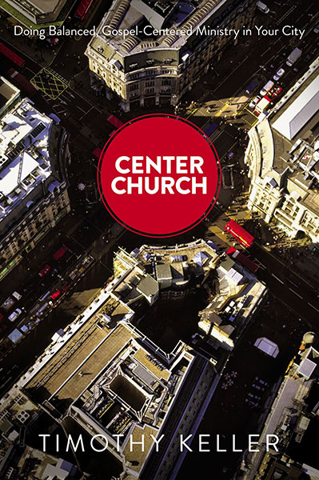
Meaning of “Missional” Christianity
Examples by:
Timothy Keller, Gary Nelson, and many others

Slide 10
Meaning of “Missional” Christianity
Interpersonal evangelism… local focus, with special sensitivity to reality of our post-Christian culture.
Local church (as institution)… applied to restructuring of goals and programs regarding outreach focus and methods.
Broad movement, initiated in Britain with Lesslie Newbigin (returned Anglican missionary from India); later in America by Timothy Keller and others.

Slide 11
Vision Development …
Kingdoms
World
Heaven
Being IN the world, but not OF it. In how many ways can we so engage?

Slide 12
From one of our core documents…
The term “missional church” refers to a church that is focused on its mission to spread the gospel and serve the community…
The idea is that the church should be actively engaged in the world around it, seeking to make a positive impact on society and culture.
The missional church movement emphasizes that all Christians should be involved in the Great Commission of Jesus Christ in every area of ministry and life.

Slide 13
Other ideas from our documents…
Are there needs to be addressed? (focus of section 1 of our Guidelines document)
Can we network effectively to address such needs? (sections 2 and 3 of our Guidelines)
What practical social needs might we focus on? (section 4 of our Guidelines) See:

Slide 14
Ideas from Missional Church literature…
We need to exhibit genuine concern for our those of our “borderlands”
We learn to better communicate using understandable language
We share in Christ’s concern for the poor and marginalized
We search for common ground with others as we look for ways to minister (physically/spiritually) to those around us.

Slide 15
Vision / Purpose / Approach… Do we need something like this?
Our purpose: to inspire and support members of our Evangelical church community as we seek to engage effectively as salt and light in the larger secular world, through:
a) Careful reflection and analysis of trends/issues of concern
b) Consultative relationships with individuals, ministries, and thinktanks
c) Refinement of our self-awareness of who we are as Kingdom People.

Slide 16
Importance of differing perspectives. How do we know if, and when, we “fully understand”?

Slide 17
Vision Development
Credits:
Article
What Are The Teachings Of Jesus On The Kingdom Of God? - Bible Hint
[https://biblehint.com/what-are-the-teachings-of-jesus-on-the-kingdom-of-god/]
Image: This is Truth
Private Site | Riflessioni, Citazioni, Citazioni d'ispirazione (pinterest.com)
[https://www.pinterest.com/pin/709387378781757700/]

